Slide 1
Optimizing Lead Conversion: Developing a Logistic Regression Model

Slide 2

Data Understanding and Preparation
Data Loading and Initial Checks
Loaded dataset from 'Leads.xlsx'.
Checked for missing values and handled them based on a predefined strategy:

Slide 3
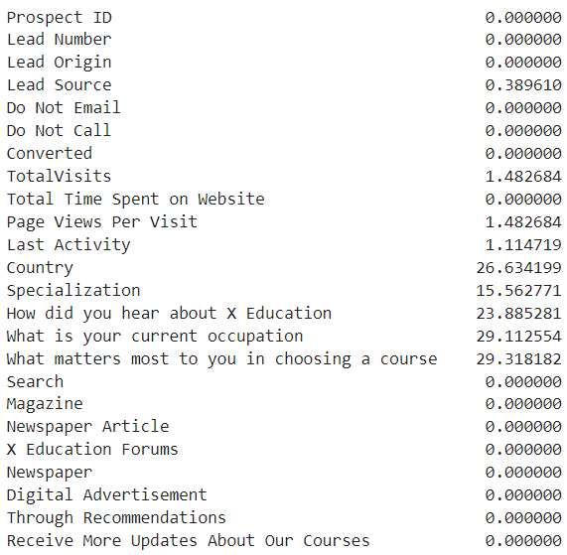
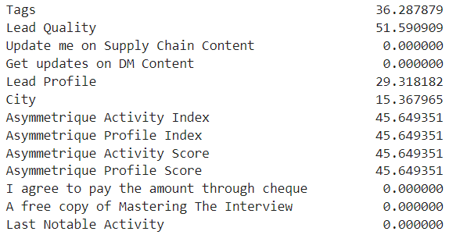
Missing Values
Initial Missing Values
Various columns with missing values ranging from 0% to 51%.
Applied cleaning strategy to handle these missing values effectively.

Slide 4

Data Cleaning
Handling Missing Values and Outliers
Deleted columns with >40% missing data.
Dropped rows with missing values in key columns.
Filled remaining missing values appropriately.
Removed duplicates and outliers for key numerical columns.

Slide 5

Standardization and Dummies
Data Standardization and Creating Dummy Variables
Standardized 'Do Not Email' and 'Do Not Call' columns.
Created dummy variables for categorical columns.
Derived new metrics like 'Time Per Visit'.

Slide 6
Exploratory Data Analysis (EDA)

Slide 7
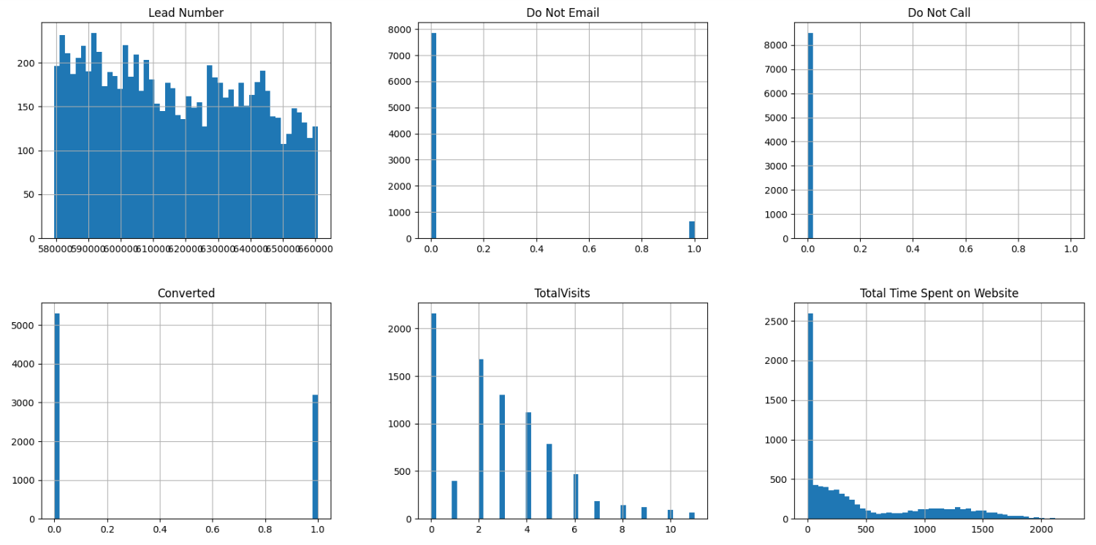
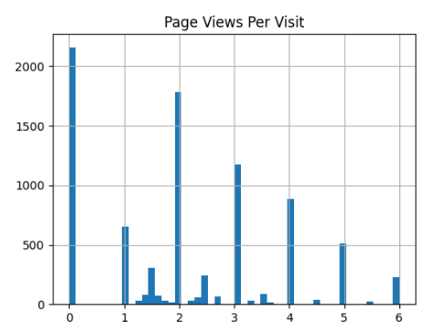
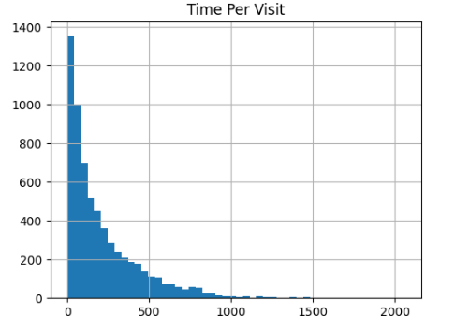
Univariate Analysis
Plotted histograms for all variables to understand distribution.

Slide 8
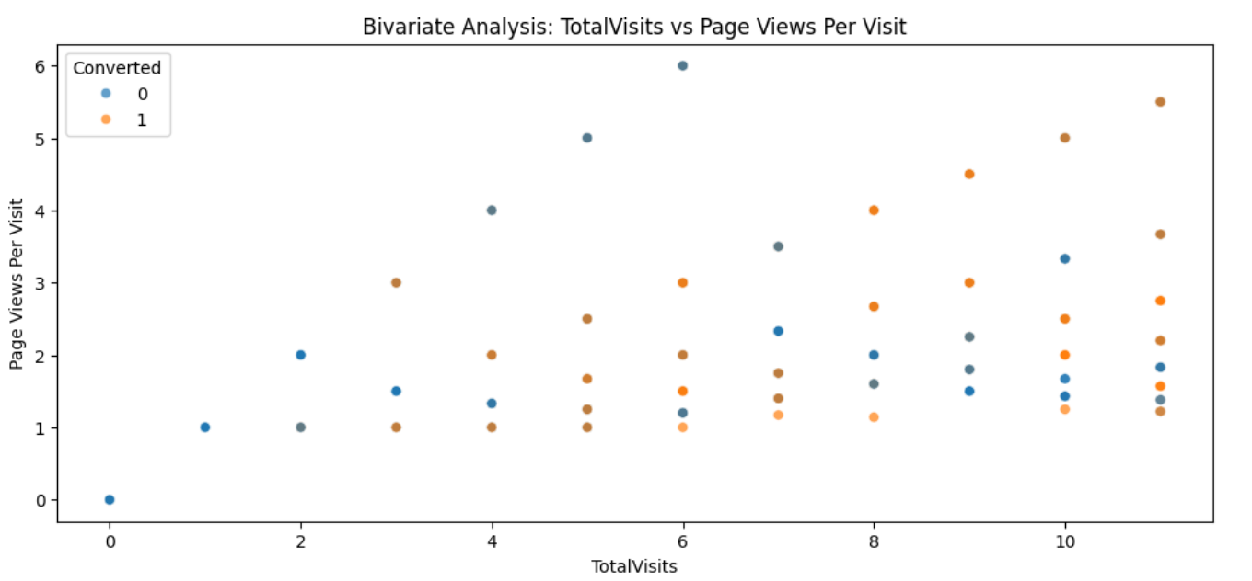
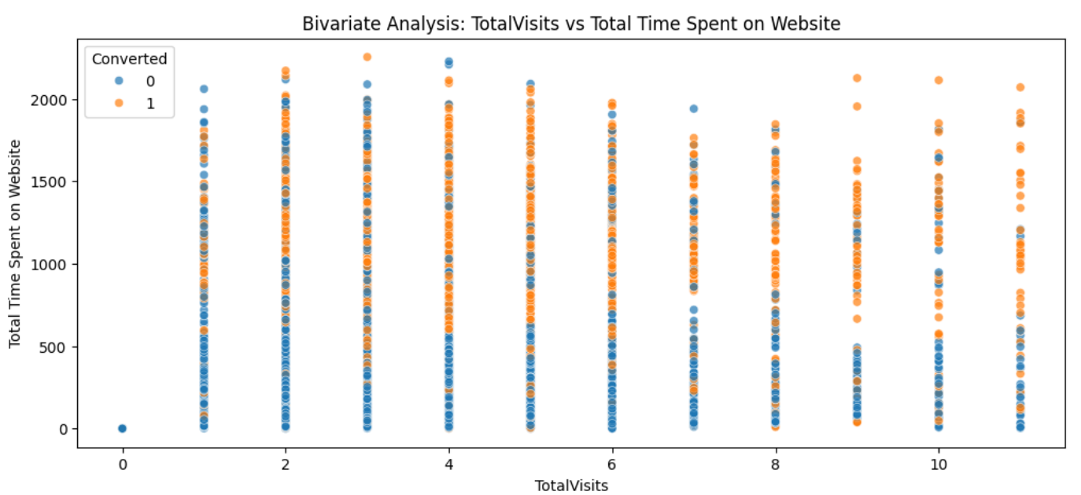
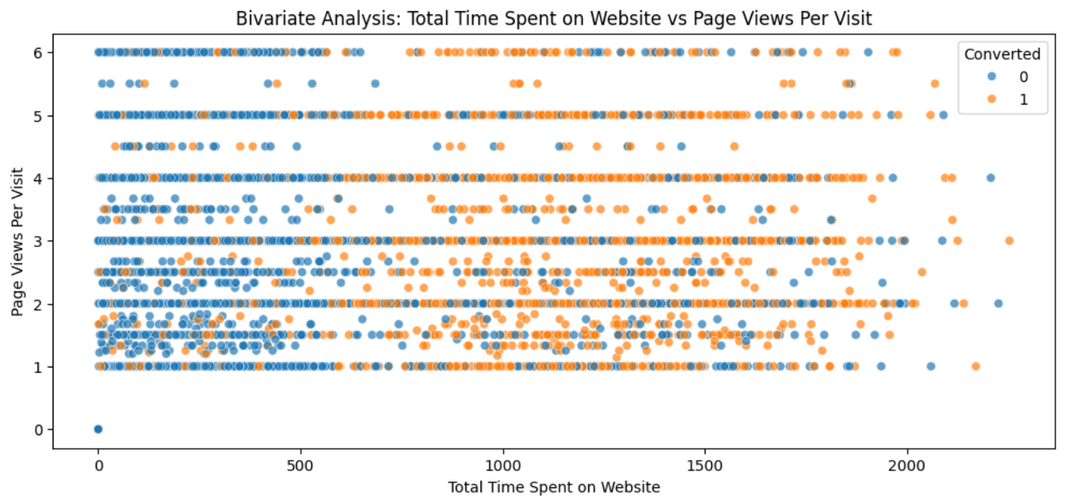
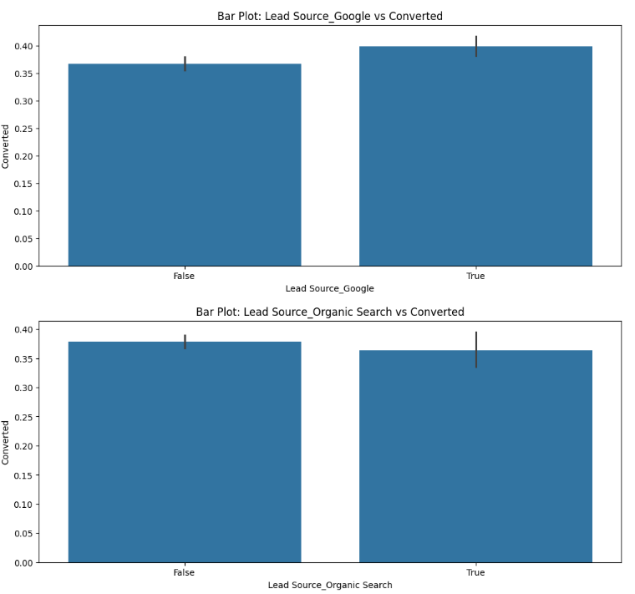
Bivariate Analysis
Scatter Plots and Box Plots

Slide 9
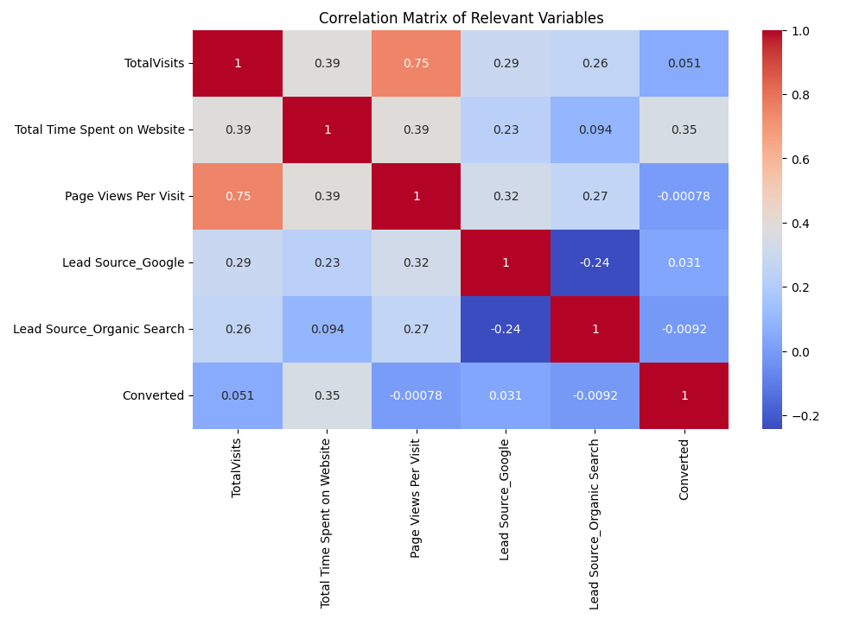
Correlation Matrix
Heat Map

Slide 10
Model Building
Logistic Regression Model
Split data into training and testing sets.
Handled missing values with SimpleImputer.
Fitted a logistic regression model with max_iter=1000.

Slide 11
Model Evaluation
Model Performance Metrics
Evaluated model using:
Accuracy: 90%
Precision: 91%
Recall: 82%
F1 Score: 87%
ROC-AUC Score: 96%

Slide 12

Model Interpretation
Top 5 Important Features
Identified top 5 features contributing to the model:
Tags_Will revert after reading the email
Tags_Lost to EINS
Tags_Closed by Horizzon
City_Select
Lead Origin_Lead Add Form

Slide 13

Recommendations
Aggressive Strategy with Interns
Prioritize leads predicted as 1.
Increase follow-up calls and emails.
Offer promotions and provide intern training.
Minimizing Calls Strategy
Focus on leads with high conversion probability (>0.8).
Reduce follow-up calls and use automated emails.
Reallocate resources to other tasks.

Slide 14
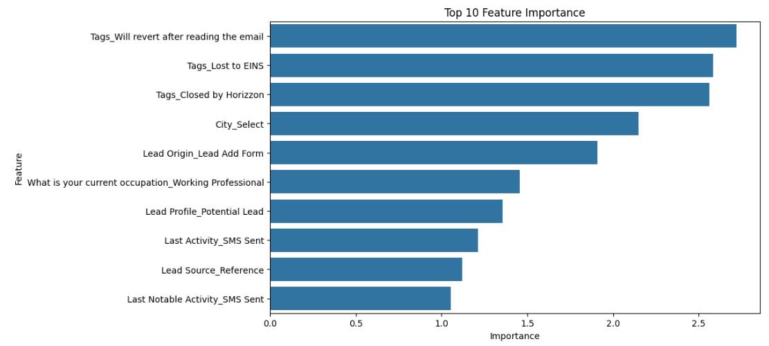
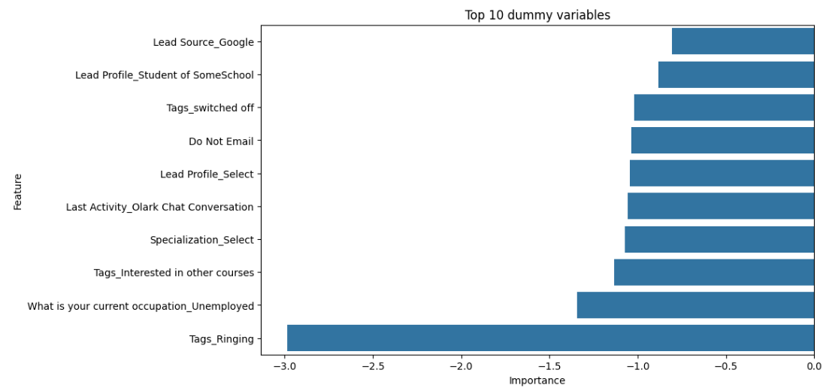
Graphs

Slide 15
Conclusion
Summary of the Analysis and Model
Effective data cleaning and preparation.
Built a robust logistic regression model.
Provided actionable recommendations based on model insights.

Slide 16
Thanks!

